Slide 1



Welcome to
CS 345 Operating Systems
Memory Management, Ch 7 (17)

Slide 2
Tip #17: Constant Comparisons
Sometimes, we tend to confuse “=” operator with “==” operator.
if (x = 1) { }
To avoid this, use the defensive programming approach of putting the constant as the first term.
if (1 = x) { }
The compiler will always complain and not compile when the statement is miswritten.
Unfortunately, this technique won’t work for comparing two variables (ie. the expression “if (x == y)” can be miss written as “if (x = y)”).

Slide 3
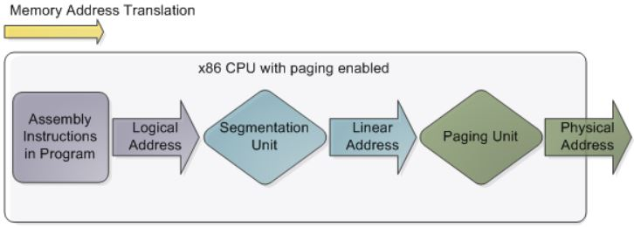
Memory Management Techniques
Fixed Partitioning
Divide memory into equal or unequal fixed size partitions at boot time
Dynamic Partitioning
Create partitions as programs loaded
Simple Paging
Divide memory into equal-size pages, load program into available pages
Simple Segmentation
Divide program into segments according to usage
Virtual-Memory Paging
Paging, but not all pages need to be in memory at one time
Virtual Memory Segmentation
Like simple segmentation, but not all segments need to be in memory at one time

Slide 4
Program Execution
What are the characteristics of an executing program?
Instructions must be in main memory
Usually has rarely used code and features
Allocated more memory than is needed
Exhibit locality
What problems result from lack of memory?
What if a program needs to “grow” while executing?
What about moving to a new machine?
What are the advantages of NOT requiring all of an executing program to be in physical memory?
Larger program address space.
More executing programs memory.
Less I/O needed to get a process going (on demand).
Unused modules would not be loaded.

Slide 5
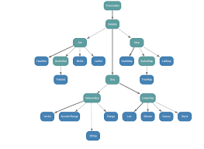
Early Memory Solutions
All larger programs had to contain logic for managing two-level storage.
Non-volatile hard drive was used to store data and code.
Programs were responsible for moving “overlays” back and forth from primary to secondary storage.
Multi-programming had to use “base and bounds registers” to manage, allocate, and reallocate memory.
Virtual memory introduced in early 60’s
1961 - First virtual memory machine, Atlas Computer in UK.
1962 - First commercial system, Burroughs B5000.
1972 – IBM introduces virtual memory in mainframes with OS/370.
1979 - Unix uses virtual memory with 3BSD.
1993 - Microsoft introduces virtual memory into Windows NT 3.
All had challenges - specialized hardware required, too much processor power required to do address translation

Slide 6
Virtual Memory
What is the difference between “real” and “virtual” memory?
Program addresses only logical addresses
Hardware maps logical addresses to physical addresses
Only part of a process is loaded into memory
process may be larger than main memory
additional processes allowed in main memory
memory loaded/unloaded as the programs execute
generally implemented using demand paging.
Real Memory – The physical memory occupied by a program (frames)
Virtual memory – The larger memory space perceived by the program (pages)

Slide 7
Memory Hierarchy
Cache memory: provides illusion of very high speed
Main memory: reasonable cost, but slow & small
Virtual memory: provides illusion of
very large size

Slide 8
Virtual Memory
What principle makes Virtual Memory possible?
Principle of Locality – A program tends to reference the same items - even if same item not used, nearby items will often be referenced.
What part(s) of a program need to be in memory?
Resident Set – Those parts of the program being actively used (remaining parts of program on disk).
What problems might occur with Virtual Memory?
Thrashing – Constantly needing to get pages off secondary storage
happens if the O.S. throws out a piece of memory that is about to be used.
can happen if the program scans a long array – continuously referencing pages not used recently.
O.S. must watch out for this situation!

Slide 9
MMU’s
What is a Memory Management Unit?
Hardware that sits between the CPU and physical memory using page tables.
Translates logical addresses to physical addresses.
Typically integrated today into the CPU.
What are page tables and where are they stored?
Memory tables (one per process) used in translating logical to physical addresses and controlling access (read/write, privileged, shared).
Originally implemented in special very fast registers, but now stored in normal memory.
Entries are cached in fast registers called Translation Look-aside Buffers (TLBs).

Slide 10
Paging
How is a program started?
Start a process with no pages in memory (pure demand paging).
Place in memory on a page fault.
At what point in a program’s execution can a page fault occur?
instruction fetch
operand fetch
operand store (any memory reference)
What is the worse case of page faulting?
VLIW or CISC instruction: Add C,A,B (C = A + B)
Instruction and all operands on different pages
4 possible page faults )-: slooooow :-(
Notes:
Adobe Photoshop does its own virtual memory
Crossing a page boundary (instruction not in memory)

Slide 11
Paging Performance
Paging Time…
Disk latency 8 milliseconds
Disk seek 15 milliseconds
Disk transfer time 1 millisecond
Total paging time ~25 milliseconds
Could be longer due to
queueing time (pending requests)
paging overhead (paging policies)
Effective access time:
EAT = (1 - p) × ma + p × pft
p is probability of page fault
ma is memory access time
pft is page fault time
Example:
EAT with 100 ns memory access and 25 ms page fault time:
EAT = (1 - p) × ma + p × pft
= (1 - p) × 100 + p × 25,000,000
= 100 + 24,999,900 × p
If we fault 1 out of 1000 (p = 0.001) accesses, what is the EAT?
EAT = 100 + 24,999,990 × 0.001
= 25 μs (250 times slowdown!)
How do we get less than 10% slowdown?
EAT ≤ 1.10 × 100 ns = 110 ns
100 + 24,999,990 × p ≤ 110 ns
Less than 1 out of 2,500,000 accesses

Slide 12
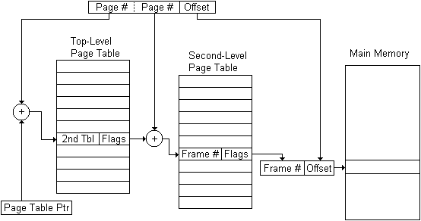
Paging Hardware
Use page number as a index into the page table, which then contains the physical frame holding that page.
Typical Flag bits: Present, Accessed, Modified, various protection-related bits.

Slide 13
Paging Hardware
How large are page tables?
4G address space with 4K pages requires 4M entries (2³² / 2¹² = 2²²)
8 byte page table entry  4M entries = 32M memory
Solutions?
Put page tables in VM space.
Most systems use multilevel page tables
Top level page table validates entire address space.
Second level page table only used if that part for part of address space.
Second level tables can also be used for shared libraries.

Slide 14
Simple Paging Hardware
Use page number as an index into the page table, which then contains the physical frame holding that page
Logical Address
Physical Address

Slide 15
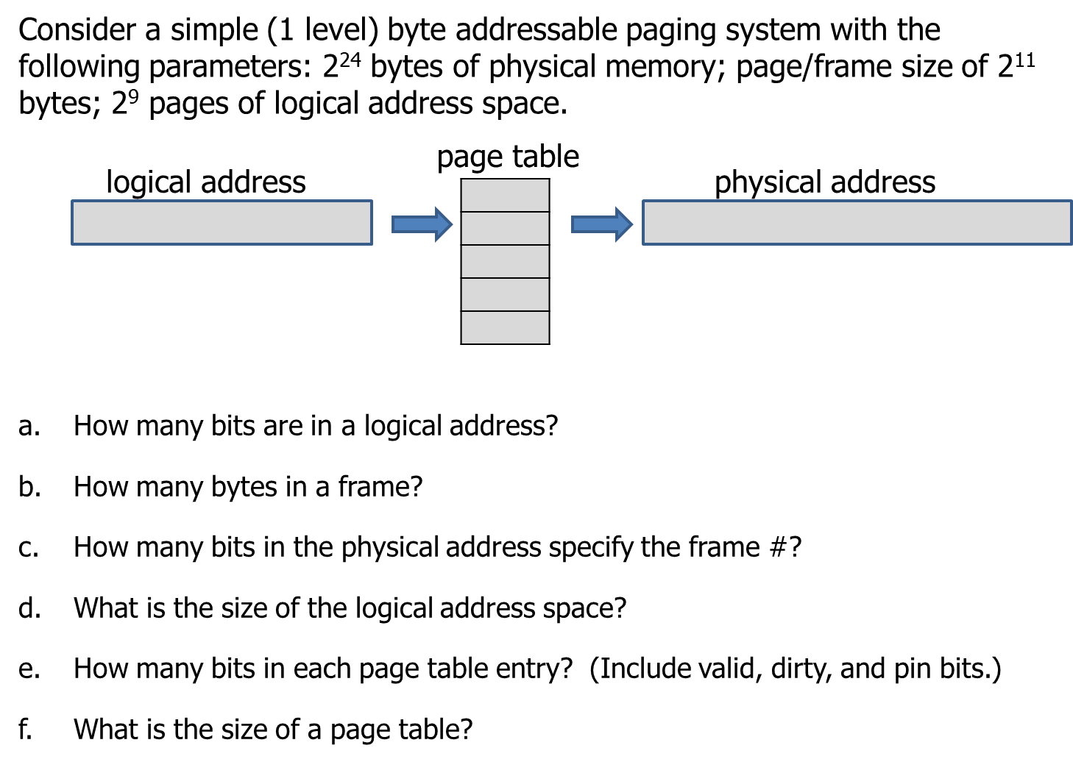
Simple Paging Quiz

Slide 16
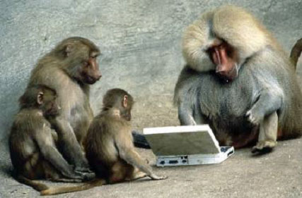

Be Safe

